Slide 1
Introduction to super resolution using deep learning
LR Image = degradation function (High resolution image)
The goal is to invert the degradation function to be able to obtain again the high resolution image. The problem? We don’t know anything about the degradation function (normally).

Slide 2
Challenges:
Find a large enough training dataset
Decide what is high-resolution and what is low-resolution
Technical challenges:
Use pre-trained deep learning model
The hardware needed is often expensive and not readily available
Quite some programming experience are needed
Advanved deep-learning know-how is required (transfer-learning, complex CNN architectures, etc.)

Slide 3
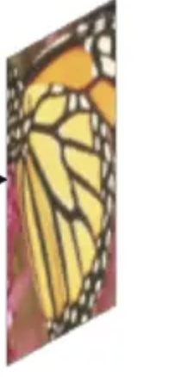

Main idea
Algorithm

Slide 4
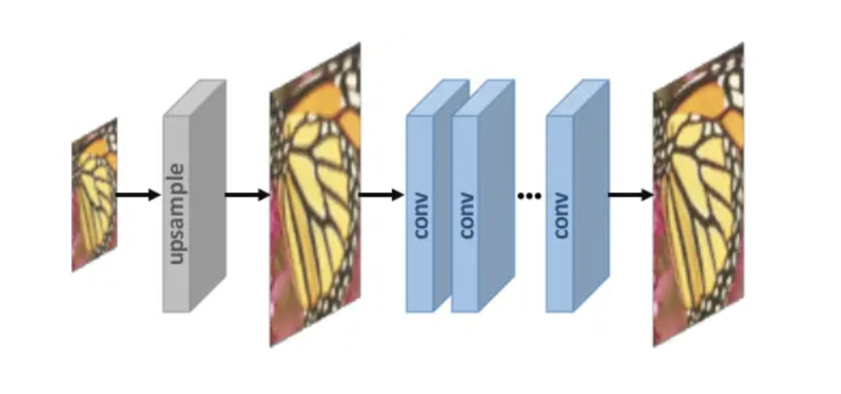
Pre-upsampling
https://arxiv.org/abs/1902.06068
Source: https://beyondminds.ai/blog/an-introduction-to-super-resolution-using-deep-learning/

Slide 5
Pre-upsampling
“The intuition was that it may be easier to first upsample the low-resolution images using traditional methods (such as Bilinear interpolation) and then refine the resultant than learn a direct mapping from a low-dimensional space to a high-dimensional space.”
https://arxiv.org/abs/1902.06068
Source: https://beyondminds.ai/blog/an-introduction-to-super-resolution-using-deep-learning/

Slide 6
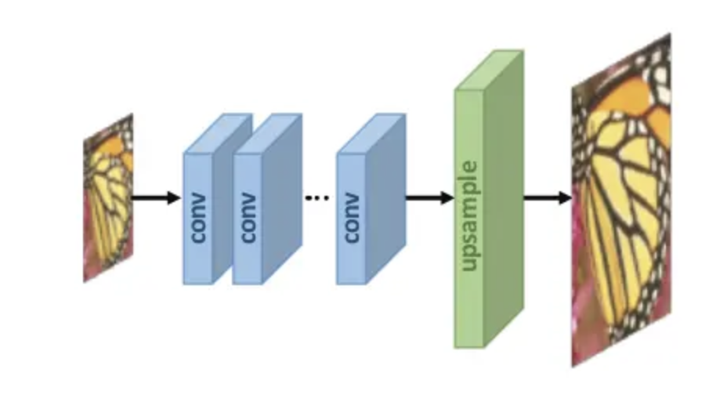
Post-upsampling
“The advantage of this method is that feature extraction is performed in the lower dimensional space (before upsampling) and hence the computational complexity is reduced. Furthermore, by using an learnable upsampling layer, the model can be trained end-to-end.”
https://arxiv.org/abs/1902.06068
Source: https://beyondminds.ai/blog/an-introduction-to-super-resolution-using-deep-learning/

Slide 7
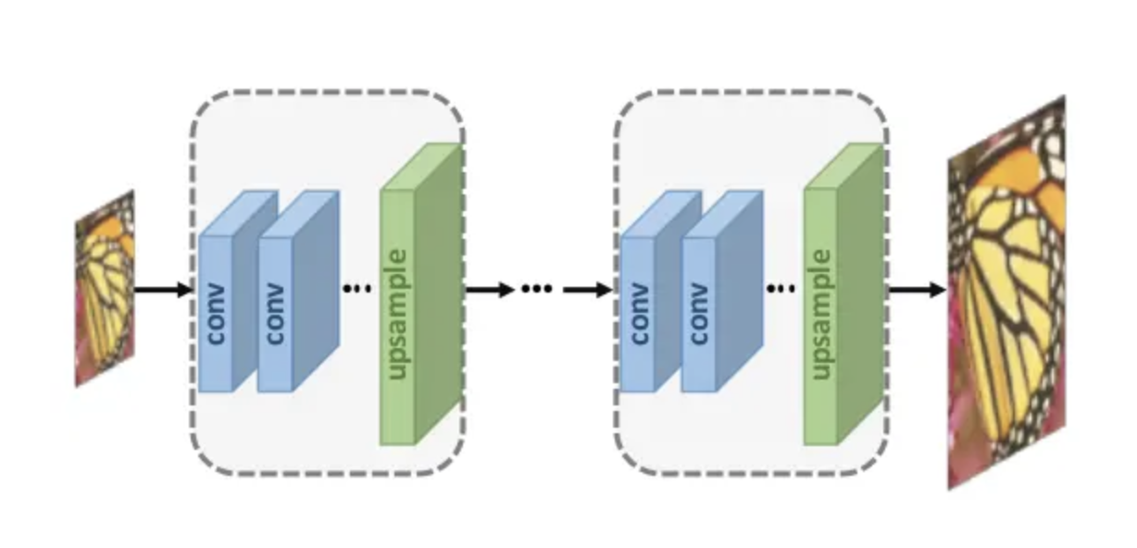
Progressive-upsampling
“By decomposing a difficult task into simpler tasks, the learning difficulty is greatly reduced and better performance can be obtained.”
https://arxiv.org/abs/1902.06068
Source: https://beyondminds.ai/blog/an-introduction-to-super-resolution-using-deep-learning/

Slide 8
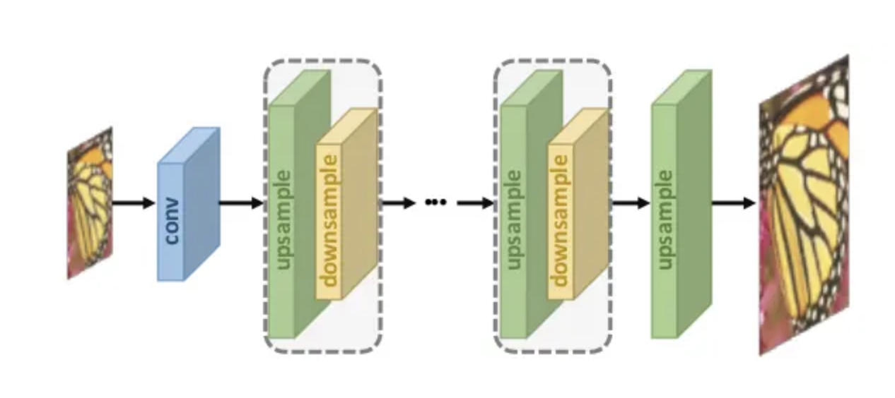
Iterative Up and Down Sampling
“The models under this framework can better mine the deep relations between the LR-HR image pairs and thus provide higher quality reconstruction results.”
https://arxiv.org/abs/1902.06068
Source: https://beyondminds.ai/blog/an-introduction-to-super-resolution-using-deep-learning/

Slide 9
Loss Functions – Some introduction

Slide 10
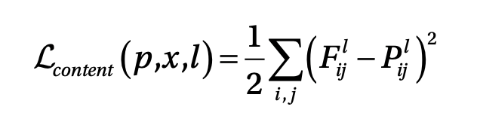
Loss Functions – Content Loss Function
Pixel Loss, Content Loss, Style Loss, and a few other variants…
SOURCE: “Advanced Applied Deep Learning -
Convolutional Neural Networks and Object Detection” by U. Michelucci - https://www.apress.com/gp/book/9781484249758
Feature map for output image from layer l
Feature map for original image (that we want to change) from layer l
https://arxiv.org/abs/1902.06068

Slide 11
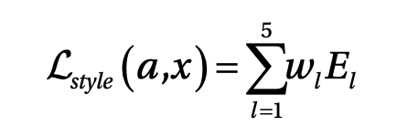
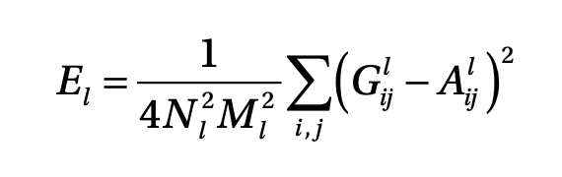
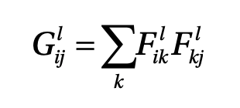
Loss Functions – Style Loss Function
Pixel Loss, Content Loss, Style Loss, and a few other variants…
SOURCE: “Advanced Applied Deep Learning -
Convolutional Neural Networks and Object Detection” by U. Michelucci - https://www.apress.com/gp/book/9781484249758
Gramian matrix for the Image that we want to use to copy the style from
Gramian matrix (correlation between layer l outputs

Slide 12
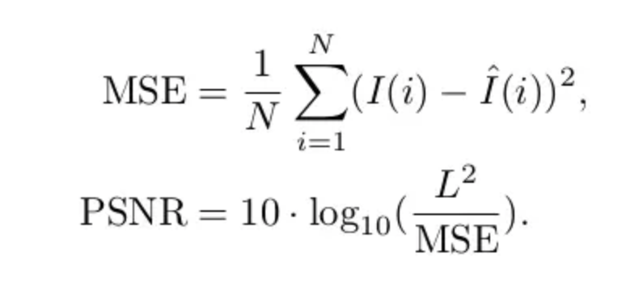
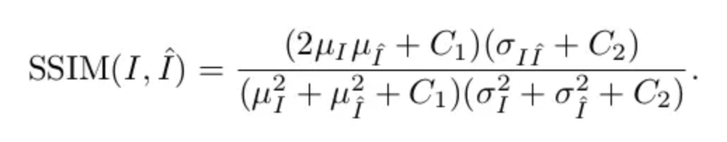
Metrics
Peak Signal-to-Noise Ratio (PSNR)
L → Max. value of pixels (8-bit pixels, L=255)
I(i) → ith pixel value of an image
Structural Similarity (SSIM)
In the formula μ(I) represents the mean of a particular image, σ(I)represents the standard deviation of a particular image,σ(I,I’)represents the covariance between two images, and C1, C2 are constants set for avoiding instability.
https://arxiv.org/abs/1902.06068

Slide 13
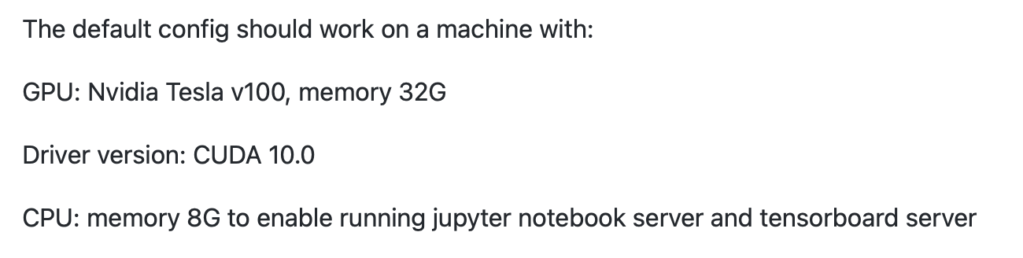
An example of existing Python codes
https://github.com/ElementAI/HighRes-net
https://github.com/idealo/image-super-resolution
https://idealo.github.io/image-super-resolution/

